Slide 1
A lecture on Boolean Algebra
Prof. Sanjay B. Dhaygude

Slide 2
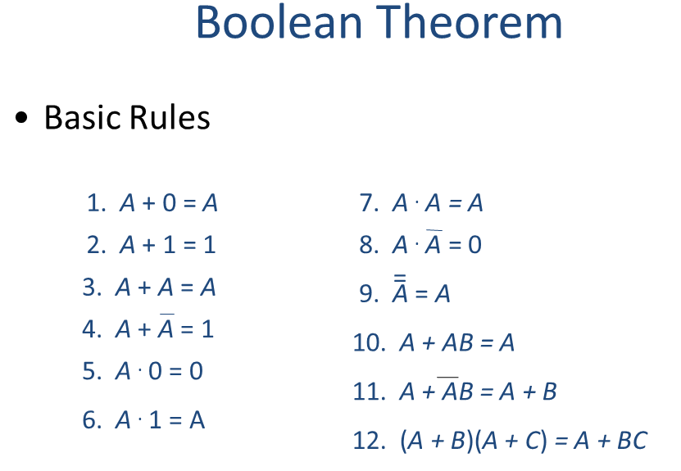

Slide 3
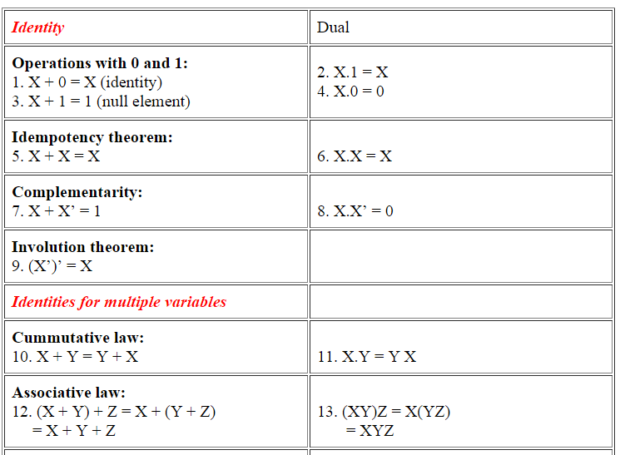
Useful Theorems

Slide 4
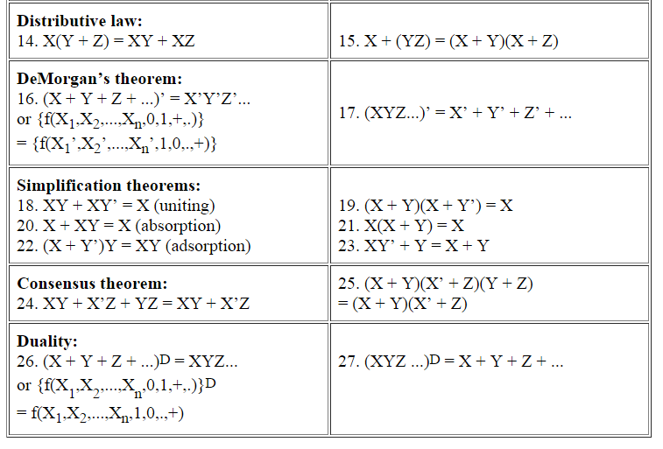

Slide 5
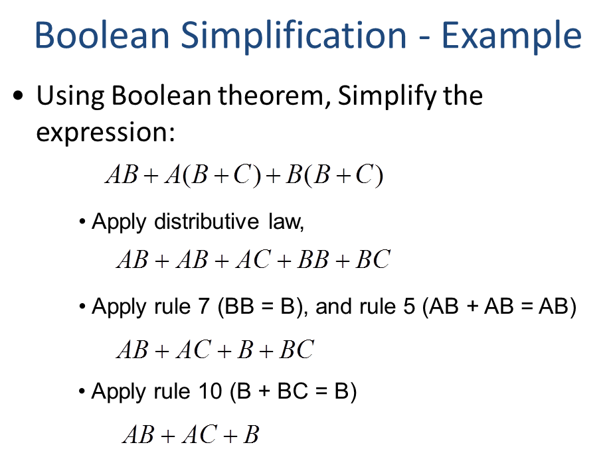

Slide 6
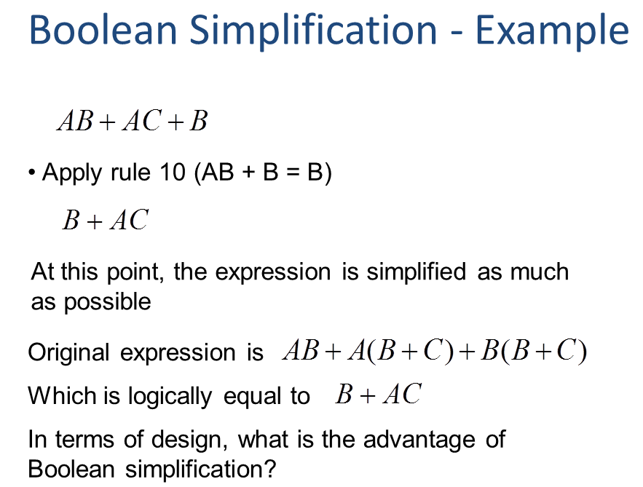

Slide 7
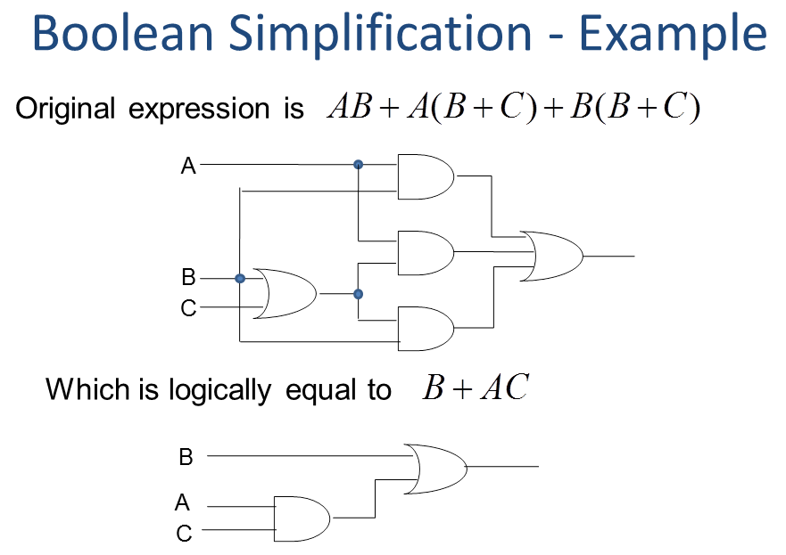

Slide 8
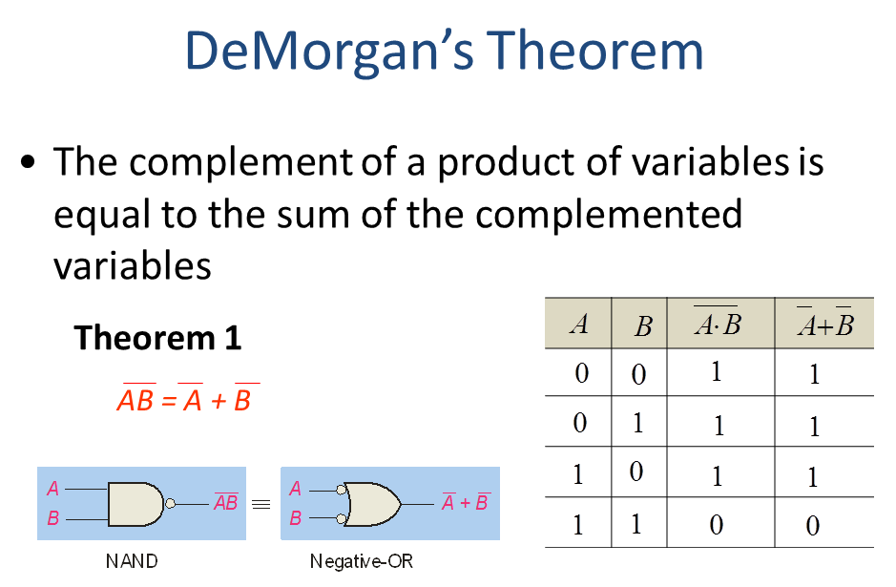

Slide 9
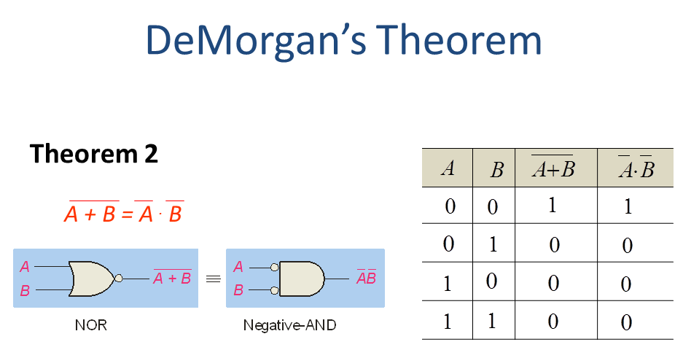

Slide 10
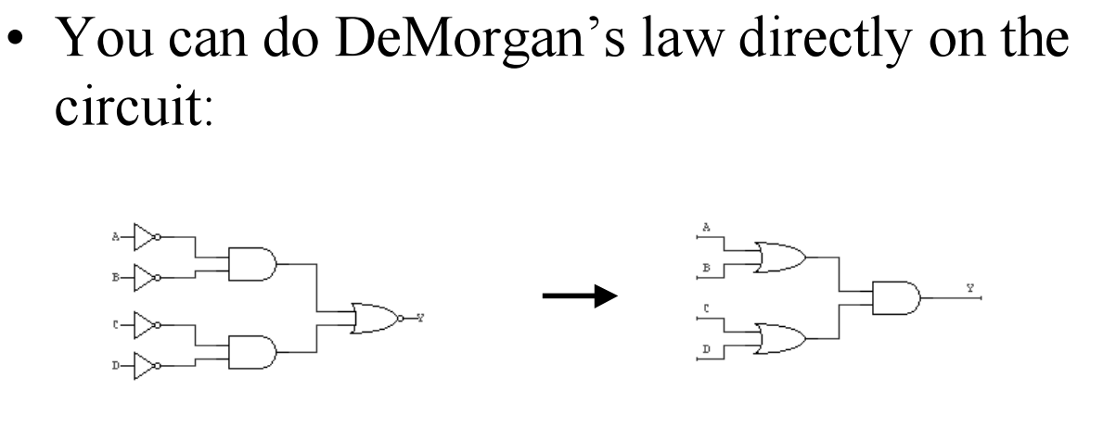
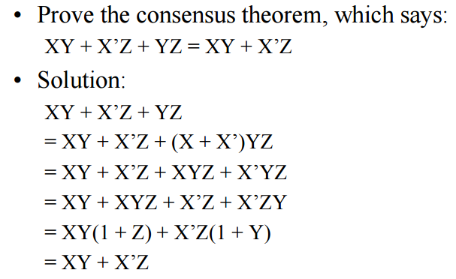

Slide 11
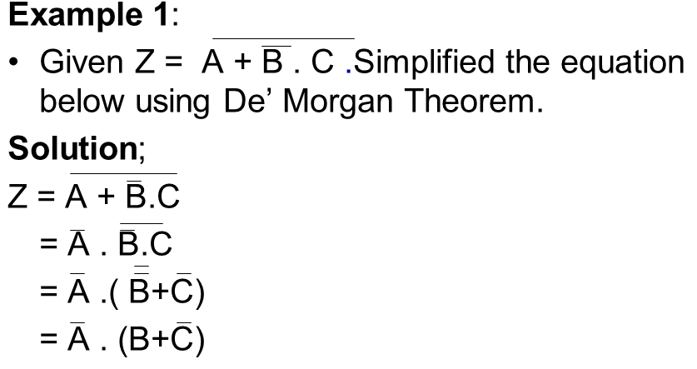

Slide 12
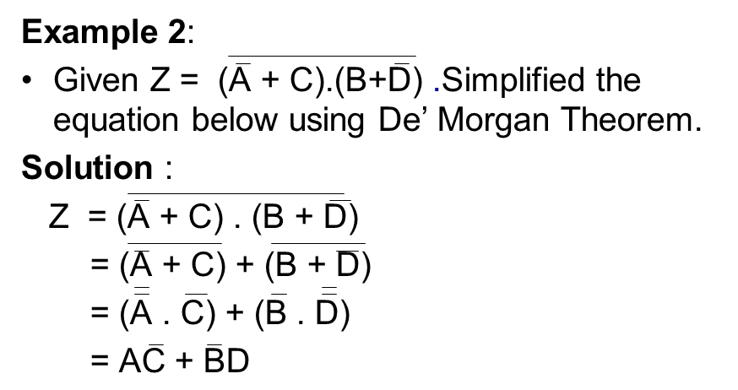

Slide 13
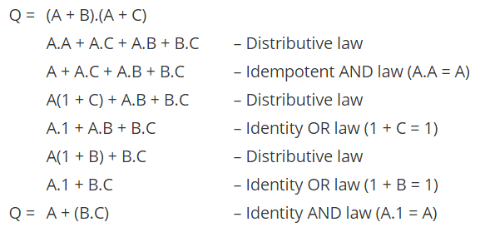
Example

Slide 14
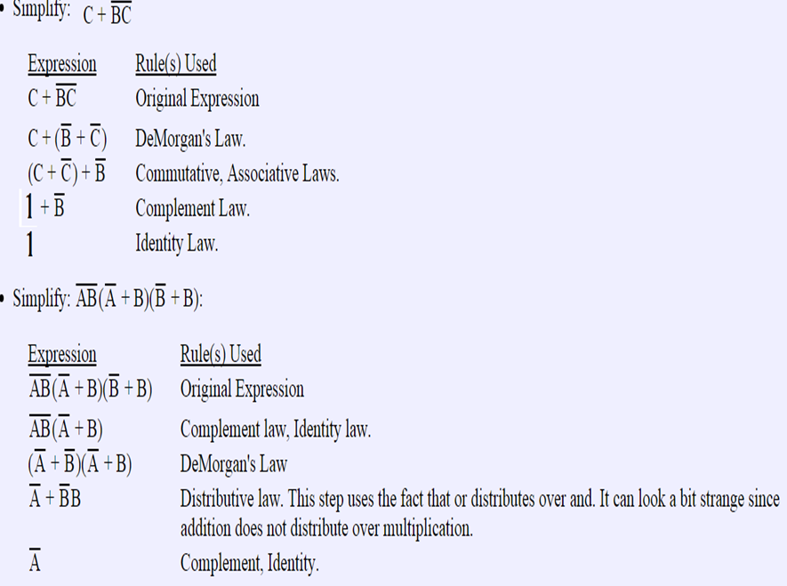

Slide 15
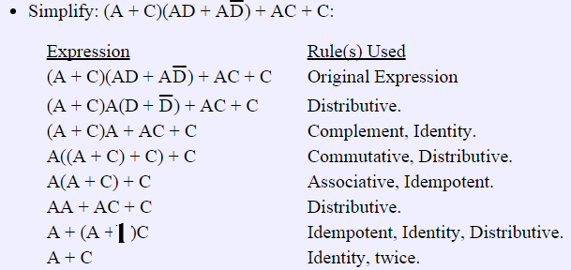

Slide 16
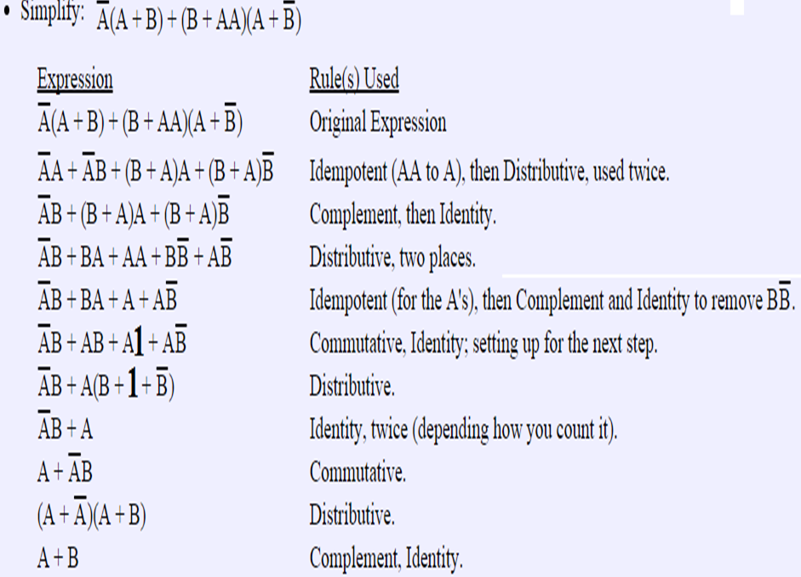

Slide 17
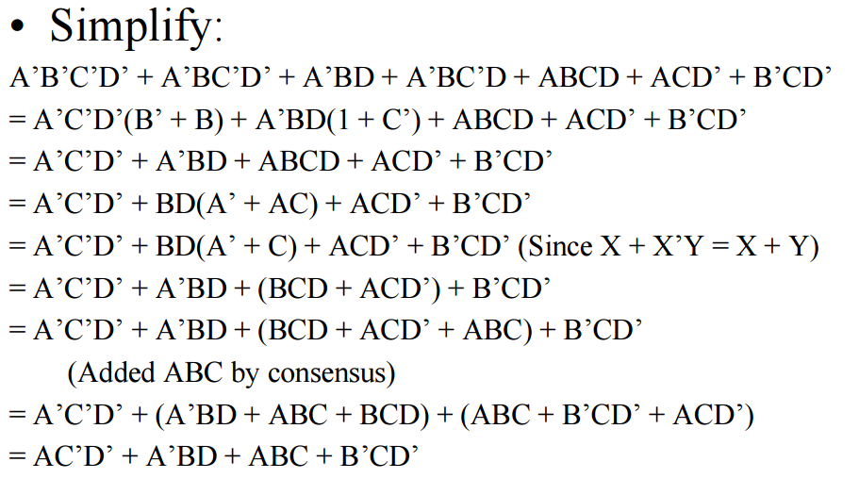

Slide 18
Canonical Forms
Minterms and Maxterms
Sum-of-Minterm (SOM) Canonical Form
Product-of-Maxterm (POM) Canonical Form
Representation of Complements of Functions
Conversions between Representations

Slide 19
Minterms
Minterms are AND terms with every variable present in either true or complemented form.
Given that each binary variable may appear normal (e.g., x) or complemented (e.g., ), there are 2^{n} minterms for n variables.
Example: Two variables (X and Y) produce 2 x 2 = 4 combinations:
(both normal)
(X normal, Y complemented)
(X complemented, Y normal)
(both complemented)
Thus there are four minterms of two variables.

Slide 20
Maxterms
Maxterms are OR terms with every variable in true or complemented form.
Given that each binary variable may appear normal (e.g., x) or complemented (e.g., x), there are 2^{n} maxterms for n variables.
Example: Two variables (X and Y) produce 2 x 2 = 4 combinations:
(both normal)
(x normal, y complemented)
(x complemented, y normal)
(both complemented)

Slide 21
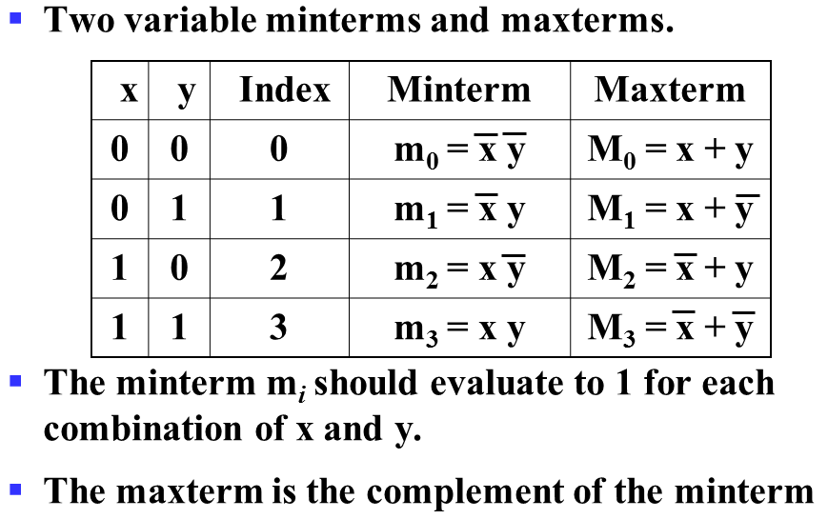
Minterms & Maxterms for 2 variables

Slide 22
Minterms & Maxterms for 3 variables
x
y
z
Index
Minterm
Maxterm
0
0
0
0
m0 = x y z
M0 = x + y + z
0
0
1
1
m1 = x y z
M1 = x + y + z
0
1
0
2
m2 = x y z
M2 = x + y + z
0
1
1
3
m3 = x y z
M3 = x + y + z
1
0
0
4
m4 = x y z
M4 = x + y + z
1
0
1
5
m5 = x y z
M5 = x + y + z
1
1
0
6
m6 = x y z
M6 = x + y + z
1
1
1
7
m7 = x y z
M7 = x + y + z
Maxterm Mi is the complement of minterm mi
Mi = mi and mi = Mi

Slide 23
Purpose of the Index
Minterms and Maxterms are designated with an index
The index number corresponds to a binary pattern
The index for the minterm or maxterm, expressed as a binary number, is used to determine whether the variable is shown in the true or complemented form
For Minterms:
‘1’ means the variable is “Not Complemented” and
‘0’ means the variable is “Complemented”.
For Maxterms:
‘0’ means the variable is “Not Complemented” and
‘1’ means the variable is “Complemented”.

Slide 24
Standard Order
All variables should be present in a minterm or maxterm and should be listed in the same order (usually alphabetically)
Example: For variables a, b, c:
Maxterms (a + b + c), (a + b + c) are in standard order
However, (b + a + c) is NOT in standard order
(a + c) does NOT contain all variables
Minterms (a b c) and (a b c) are in standard order
However, (b a c) is not in standard order
(a c) does not contain all variables

Slide 25
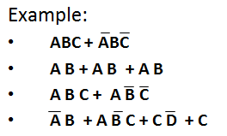
Sum-of-Products
SOP expressions consist of two or more AND terms (products) that are OR ed together
In SOP an inversion cannot cover more than one variable in a term
SOP is also call as Sum-of-Minterms

Slide 26
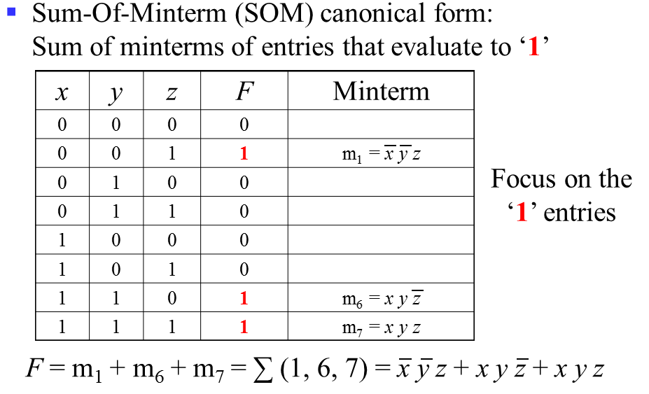
Sum-Of-Minterm (SOM)

Slide 27
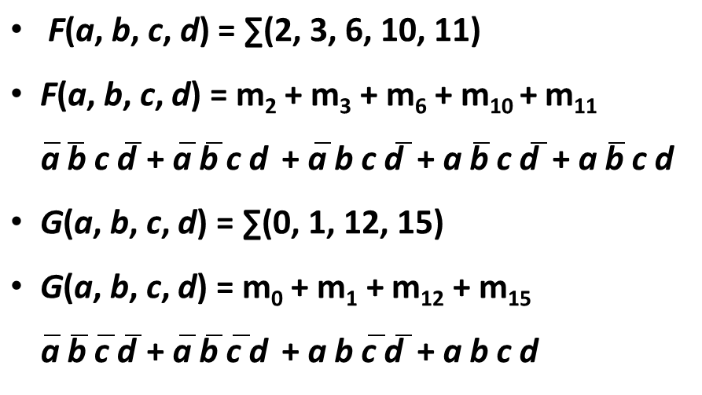
Sum-Of-Minterm Examples

Slide 28
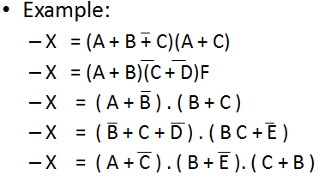
Product-of-Sums
POS expressions consist of two or more OR terms (sums) that are AND ed together
POS is also call as Sum-of-Maxterms

Slide 29
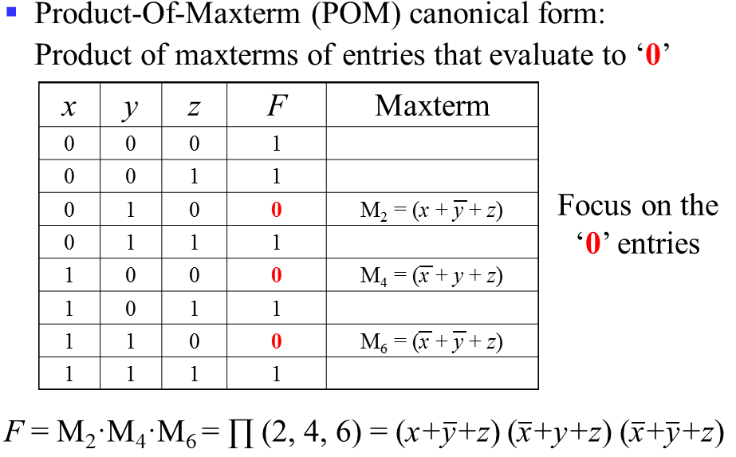
Product-Of-Maxterm (POM)

Slide 30
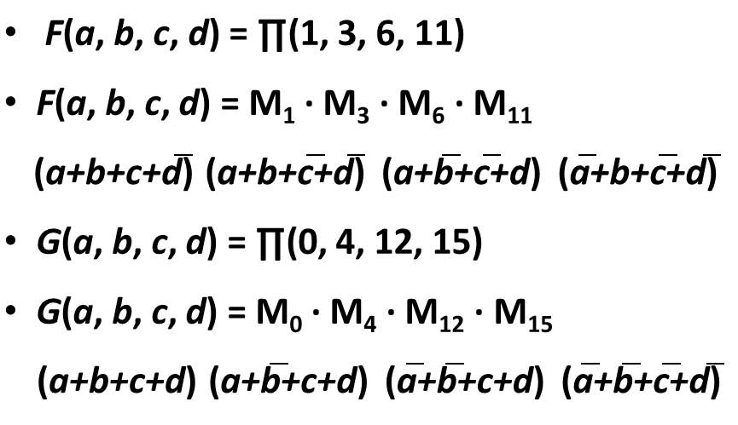
Product-Of-Maxterm Examples

Slide 31
Example
Minimize the following Boolean function using sum of products (SOP):
f(a,b,c,d) = ∑m(3,7,11,12,13,14,15)
 | abcd
3 | 0011 | a`b`cd
7 | 0111 | a`bcd
11 | 1011 | ab`cd
12 | 1100 | abc`d`
13 | 1101 | abc`d
14 | 1110 | abcd`
15 | 1111 | abcd
Notes:
31

Slide 32
Example
f(a,b,c,d) = ∑m(3,7,11,12,13,14,15)
=a`b`cd + a`bcd + ab`cd + abc`d`+ abc`d + abcd` + abcd
=cd(a`b` + a`b + ab`) + ab(c`d` + c`d + cd` + cd )
=cd(a`[b` + b] + ab`) + ab(c`[d` + d] + c[d` + d])
=cd(a`[1] + ab`) + ab(c`[1] + c[1])
=ab+ab`cd + a`cd
=ab+cd(ab` + a`)
=ab+ cd(a + a`)(a`+b`)
= ab + a`cd + b`cd
= ab +cd(a` + b`)

Slide 33
Example
f(a,b,c,d) = ∏M(0,1,2,4,5,6,8,9,10)
=∑m(3,7,11,12,13,14,15)
=[(a+b+c+d)(a+b+c+d`)(a+b`+c`+d`)
(a`+b+c`+d`)(a`+b`+c+ d)(a`+b`+c+ d`) (a`+b`+c`+d)(a`+b`+c`+d`)]

Slide 34
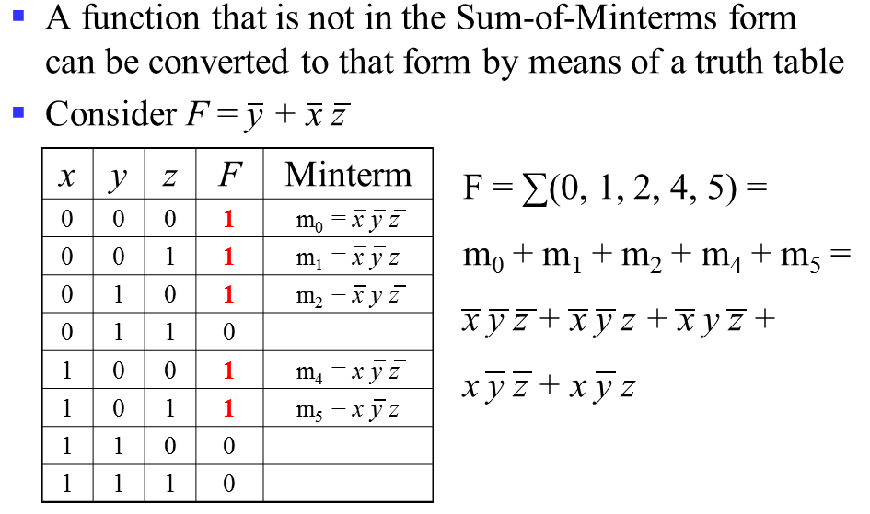
Converting to Sum-of-Minterms Form

Slide 35
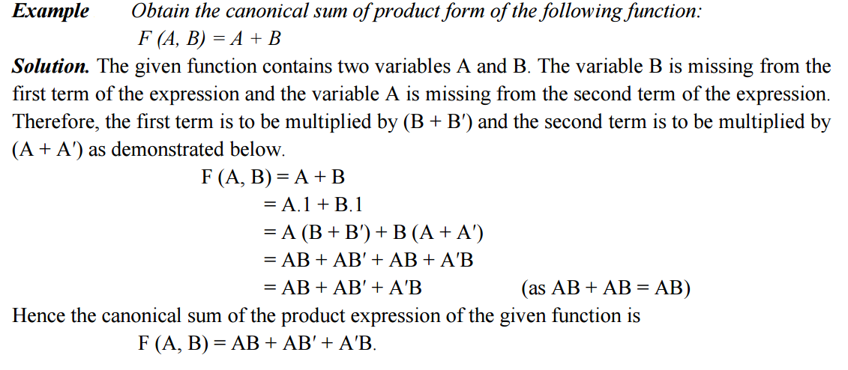

Slide 36
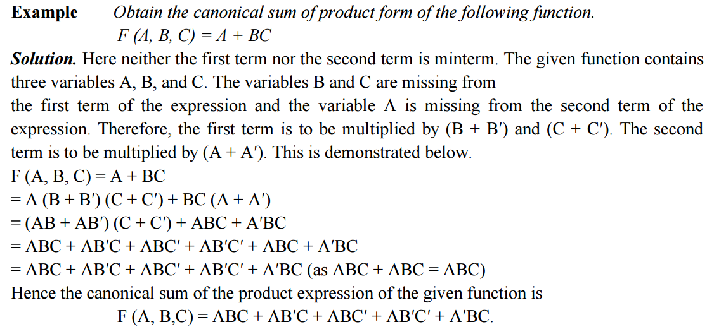

Slide 37
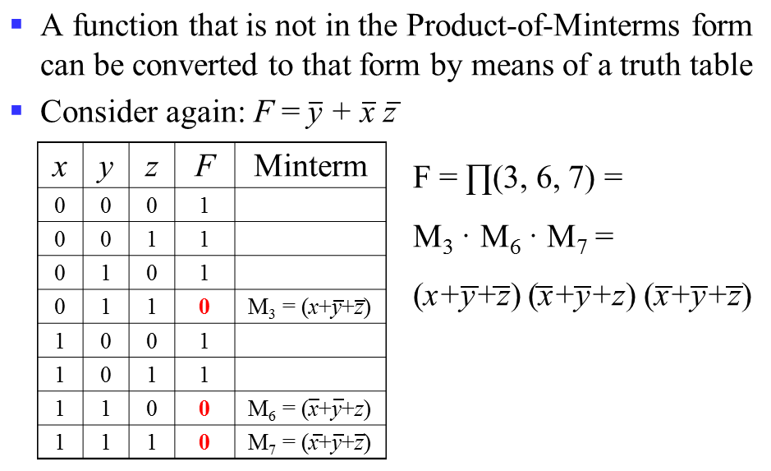
Converting to Product-of-Maxterms Form

Slide 38
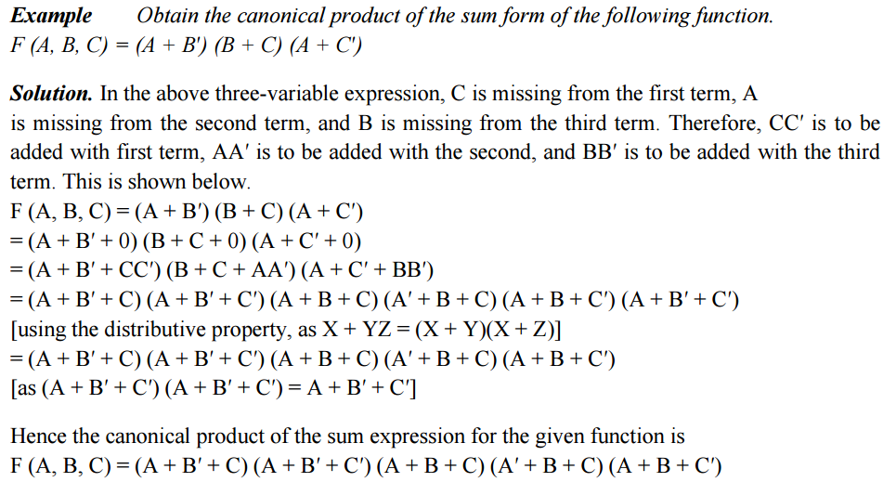

Slide 39
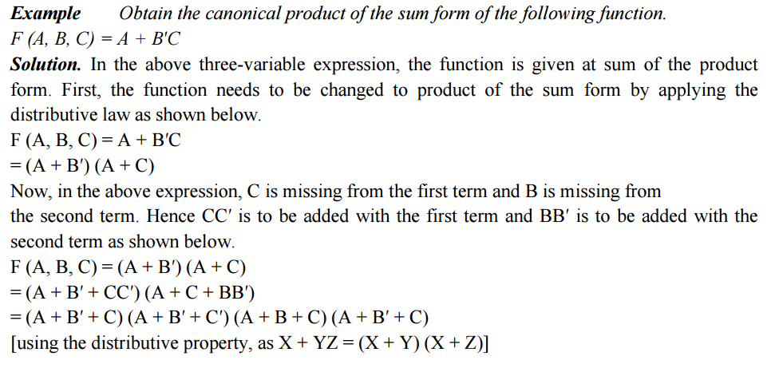

Slide 40
Karnaugh Map Method
A graphical method of simplifying logic equations or truth tables.
Also called a K map.
Theoretically can be used for any number of input variables, but practically limited to 5 or 6 variables.

Slide 41
Karnaugh Map Method
The truth table values are placed in the K map.
Adjacent K map square differ in only one variable both horizontally and vertically.
The pattern from top to bottom and left to right must be in the form
A SOP expression can be obtained by ORing all squares that contain a 1.

Slide 42
Karnaugh Map Method
Looping adjacent groups of 2, 4, or 8 1s will result in further simplification.
When the largest possible groups have been looped, only the common terms are placed in the final expression.
Looping may also be wrapped between top, bottom, and sides.
Looping a pair (or quad or octet and so on) of adjacent 1s in a K map eliminates the variable that appears in complemented and un-complemented form.

Slide 43
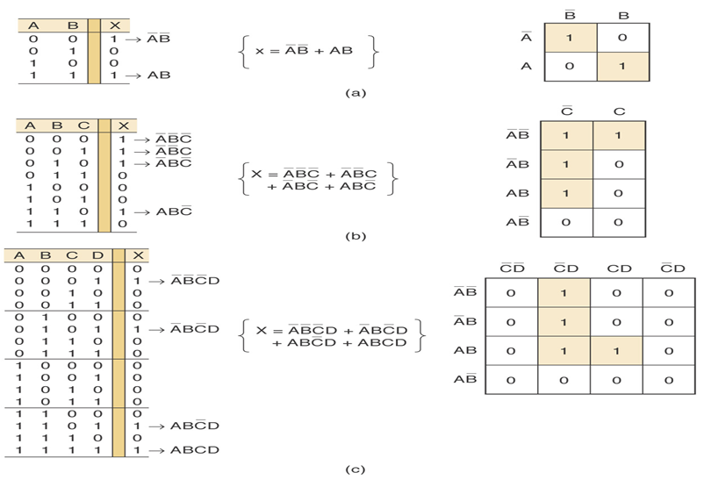
Karnaugh maps and truth tables for (a) two, (b) three, and (c) four variables.

Slide 44
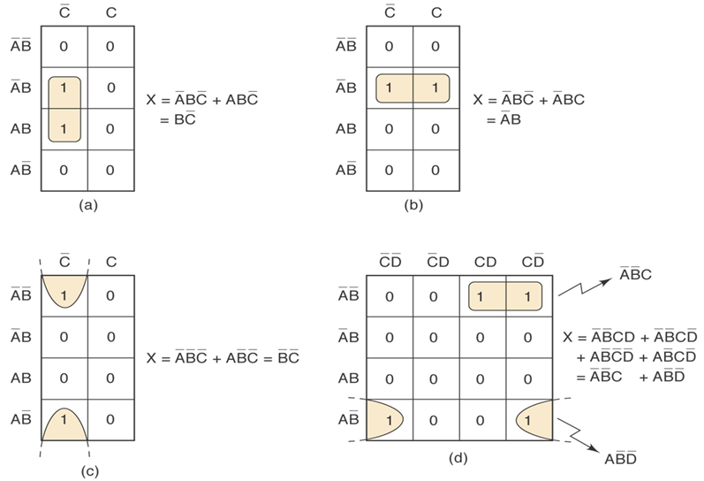
Examples of looping pairs of adjacent 1s.

Slide 45
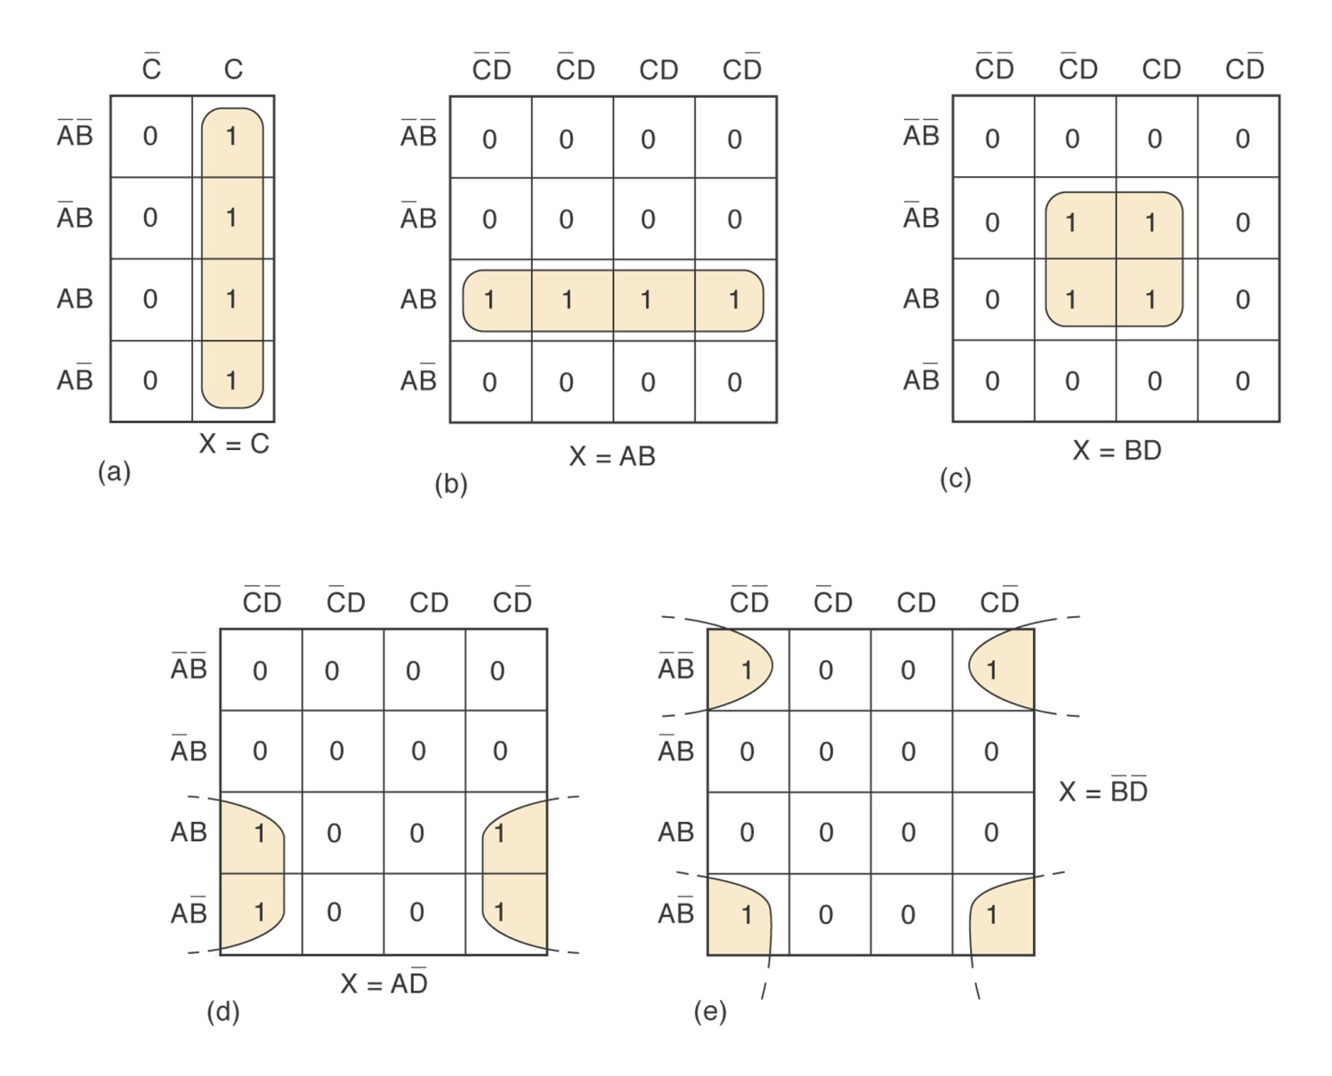
Examples of looping groups of fours 1s (quads).

Slide 46
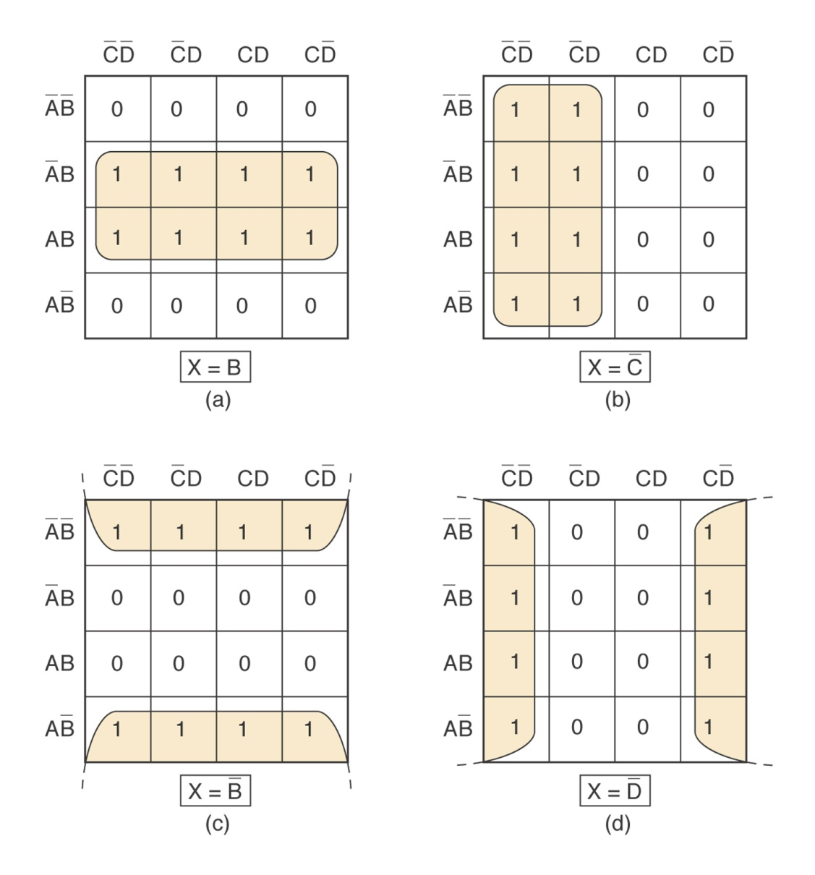
Examples of looping groups of eight 1s (octets).

Slide 47
Karnaugh Map Method
Complete K map simplification process
Construct the K map, place 1s as indicated in the truth table.
Loop 1s that are not adjacent to any other 1s. (Isolated 1s)
Loop 1s that are in pairs
Loop 1s in octets even if they have already been looped.
Loop quads that have one or more 1s not already looped. (Use minimum number of loops)
Loop any pairs necessary to include 1s not already looped.
Form the OR sum of terms generated by each loop.

Slide 48
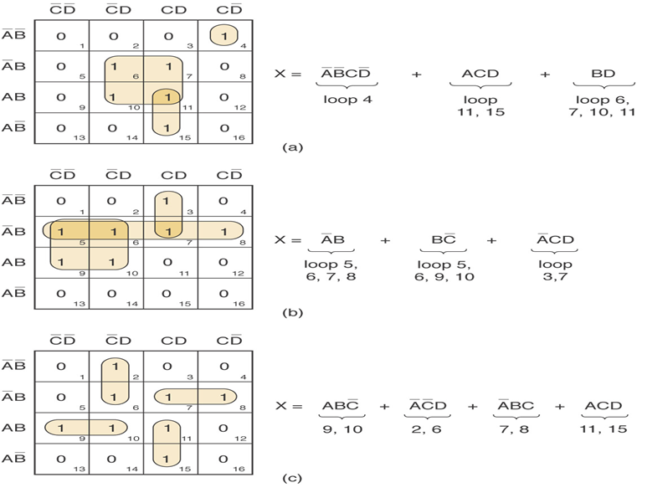
Examples :

Slide 49
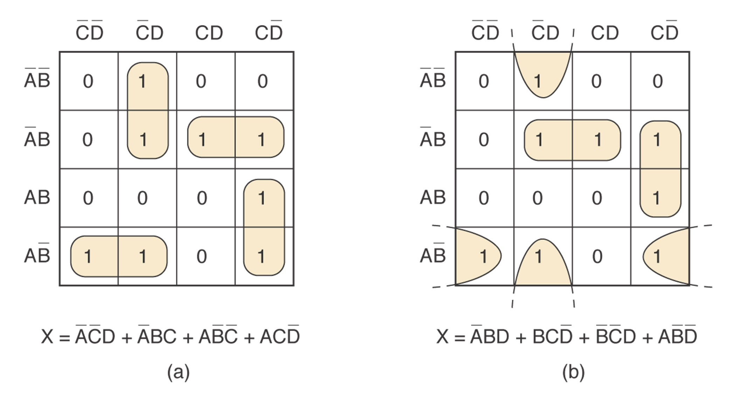
Example : The same K map with two equally good solutions.

Slide 50
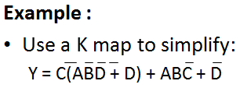
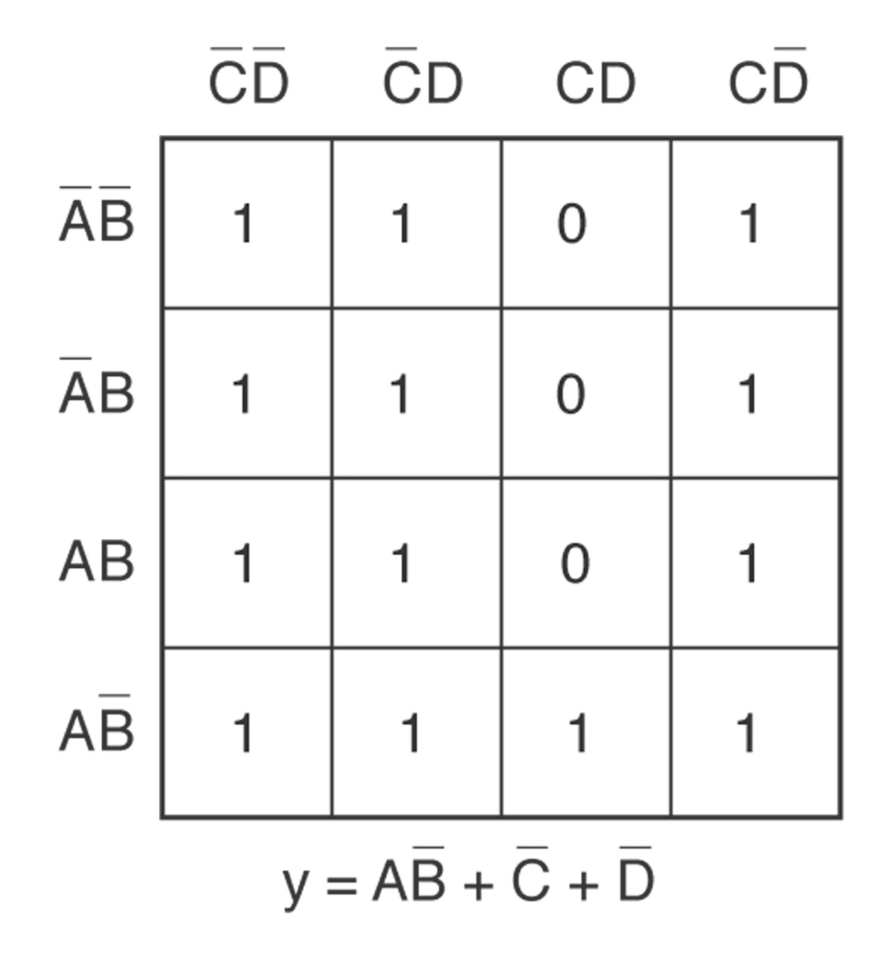

Slide 51
Three variable map
f(A,B,C) = ∑m(0,3,5)= A`B`C`+A`BC+AB’C
A`B` 0 0 | A`B 0 1 | A B 1 1 | A B` 1 0
C` 0
C 1
1
 | 1 A`BC |  | 1 AB`C
A`B`C`
Notes:
51

Slide 52
Maxterm example
(A+B) (A+B`) (A`+B`) (A`+B)
A`B` | A`B | AB | AB`
C
C`
C
 | 0 | 0 | 0
0 |  | 0
C`
f(A,B,C) = ∏M(1,2,4,6,7)
=(A+B+C`)(A+B`+C)(A`+B+C) )(A`+B`+C) (A`+B`+C`)
Note that the complements are (0,3,5) which are the minterms of the previous example
Notes:
52

Slide 53
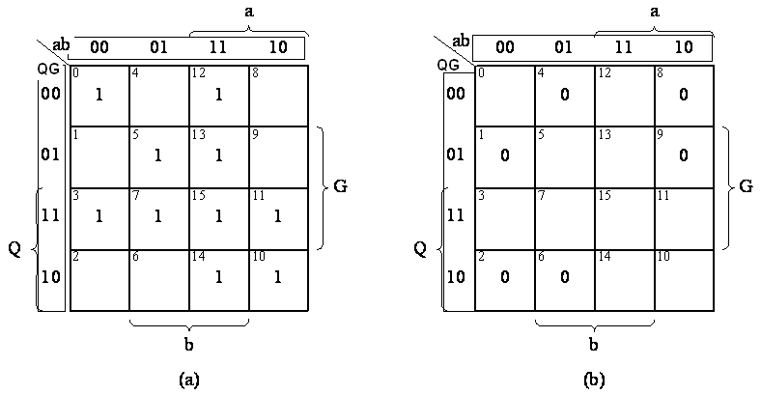
Four variable example (a) Minterm form. (b) Maxterm form.
f(a,b,Q,G) = ∑m(0,3,5,7,10,11,12,13,14,15) = ∏M(1,2,4,6,8,9)
Notes:
53

Slide 54
Example Simplify f= A`BC`+ A B C`+ A B C using; (a) Sum of minterms. (b) Maxterms.
Each cell of an n-variable K-map has n logically adjacent cells.
F`= B`+ A`C
F = B(A+C`)
a- f(A,B,C) = AB + BC′
b- f(A,B,C) = B(A + C′)
Notes:
54

Slide 55
Example Simplify
f(A,B,C,D) = ∑m(2,3,4,5,7,8,10,13,15)
Notes:
55

Slide 56
Example Multiple selections
f(A,B,C,D) = ∑m(2,3,4,5,7,8,10,13,15)
c produces less terms than a
Notes:
56

Slide 57
Example Redundant selections f(A,B,C,D) = ∑m(0,5,7,8,10,12,14,15)
Notes:
57

Slide 58
f(A,B,C,D) = ∑m(1,2,4,6,9)

Slide 59
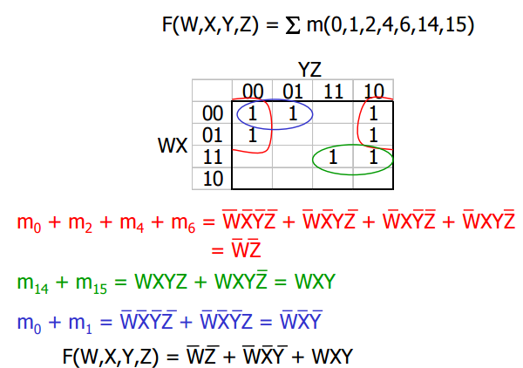
Example:

Slide 60
Different styles of drawing maps f(A,B,C) = ∑m(1,2,3,6) = A′C + BC′
BC
A
00
01
11
10
1
1
1
0
1
1
C
0
1
AB
 | 1
1 | 1
1
00
01
11
10
Notes:
60

Slide 61
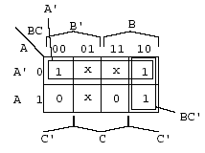
Don’t-care condition
Minterms that may produce either 0 or 1 for the function.
They are marked with an × in the K-map.
This happens, for example, when we don’t input certain minterms to the Boolean function.
These don’t-care conditions can be used to provide further simplification of the algebraic expression.
(Example) F = A`B`C`+A`BC` + ABC`
d=A`B`C +A`BC + AB`C
F = A` + BC`
Notes:
61

Slide 62
Five variable K-maps Use Two Four-variable K-Maps
a` | f
0 | 1
1
2
3
4
5 | 1
6
7 | 1
8
9
10
11
12
13 | 1
14
15 | 1
a | f
16 | 1
17
18
19
20
21 | 1
22
23 | 1
24
25
26
27
28
29 | 1
30
31 | 1
f(a,b,c,d,e) = ∑m(0,5,7,13,15,16,21,23,29,31)
a`=0 map
a=1 map
1
1
1
1
1
1
1
1
1
1
Notes:
62

Slide 63
F=(a+a`)ce + (a+a`)b`c`d`e` =ce + b`c`d`e`
a`=0 map
a=1 map
1
1
1
1
1
1
1
1
1
1
F1=a`b`c`d`e` + a`ce, F2=ace + ab`c`d`e`
f(a,b,c,d,e) = f1+f2
Notes:
63

Slide 64
Define logic gates
A logic gate performs a logical operation on one or more logic inputs and produces a single logic output and most commonly found at digital circuits.
1.Explain the operation of logic gates. 2.Draw logic symbols for gates. 3.Construct truth table of logic gates.

Slide 65
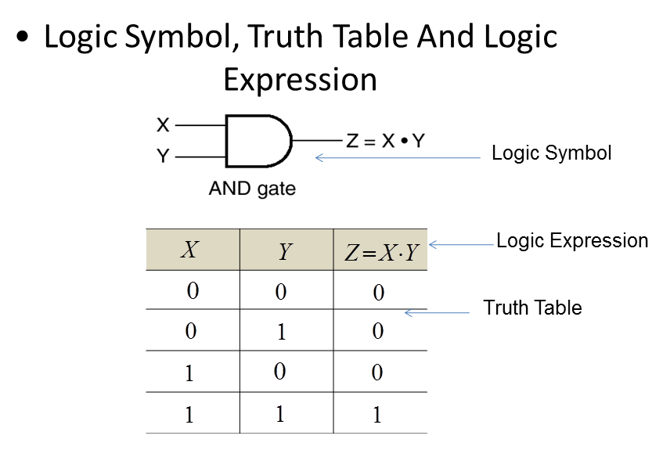
AND Gate

Slide 66
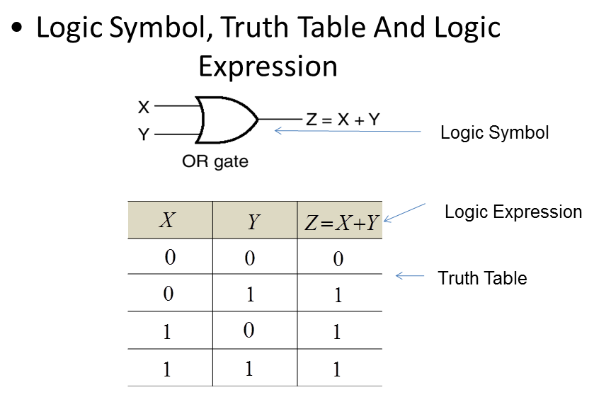
OR Gate

Slide 67
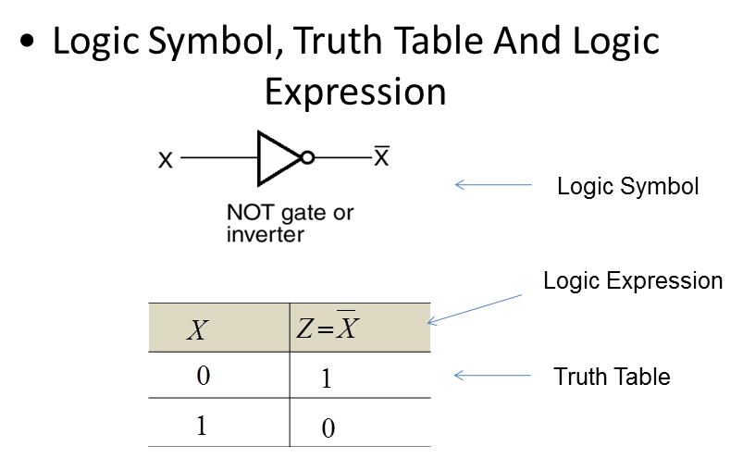
Inverter/Not Gate

Slide 68
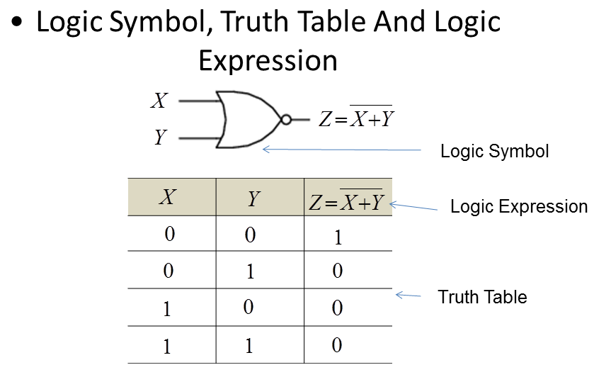
NOR

Slide 69
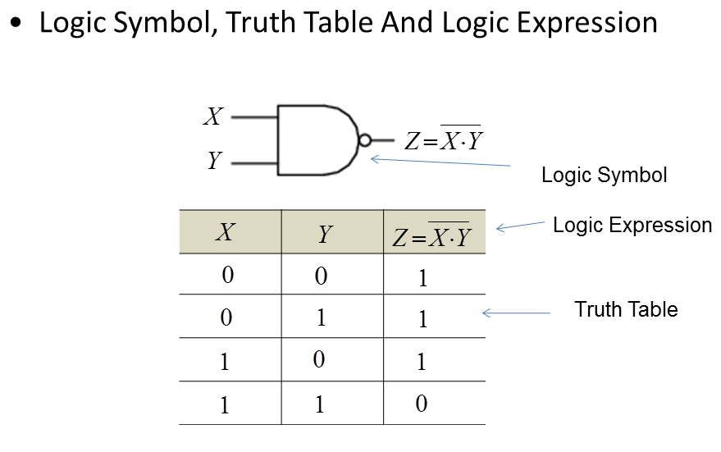
NAND

Slide 70
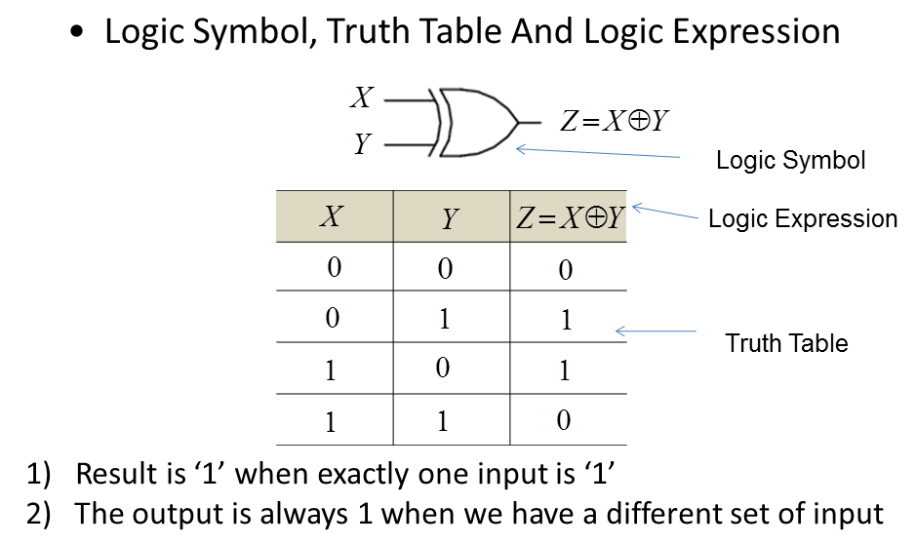
XOR

Slide 71
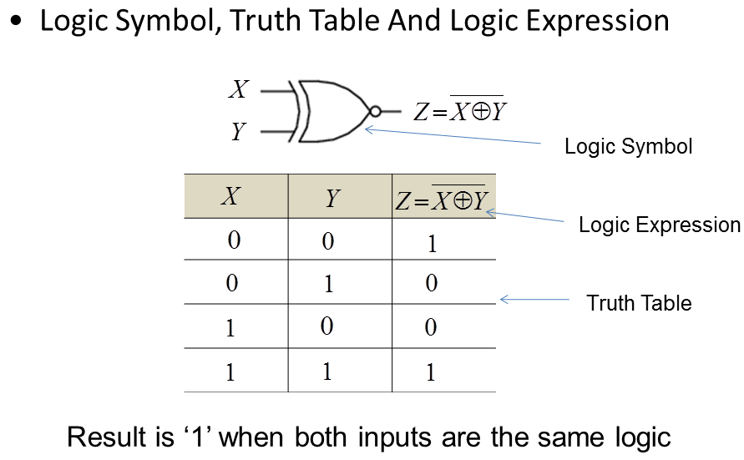
XNOR

Slide 72
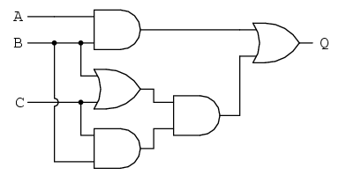
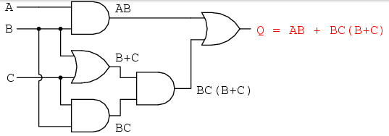


Circuit Simplification Examples

Slide 73


